Slide 1


Gaussian Process Regression for Efficient Detection of Fabrication Inaccuracies in Microsensors
Filippo Zacchei
April 2025
PhD Course: Advanced Statistical Methods for Complex data
Prof. Francesca Ieva

Slide 2
outline
Context and Motivation
Gaussian Process Regression
A Comparison with Kriging
GPR for Online Learning
Numerical Results

Slide 3

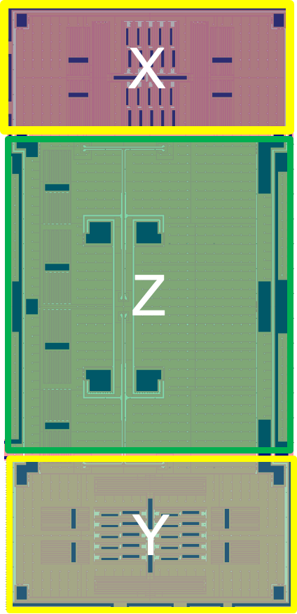
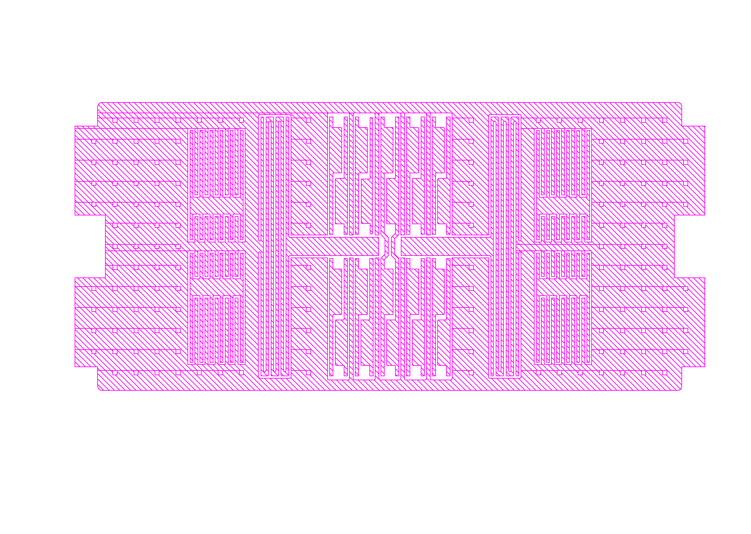
Objective
Calibration of MEMS accelerometers:
Fabrication may lead geometrical layout to differ up to 10% w.r.t. the intended one.
The sensitivity of the device w.r.t. external accelerations is highly impacted by fabrication inaccuracies.
Sensitivity is generally estimated using labor intensive mechanical tests.
Calibration of MEMS accelerometer using cheap electronic tests

Slide 4
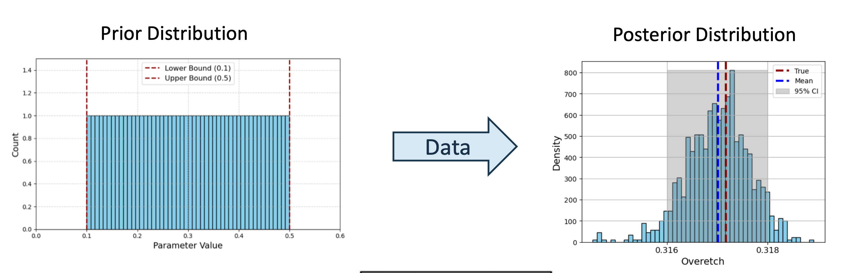
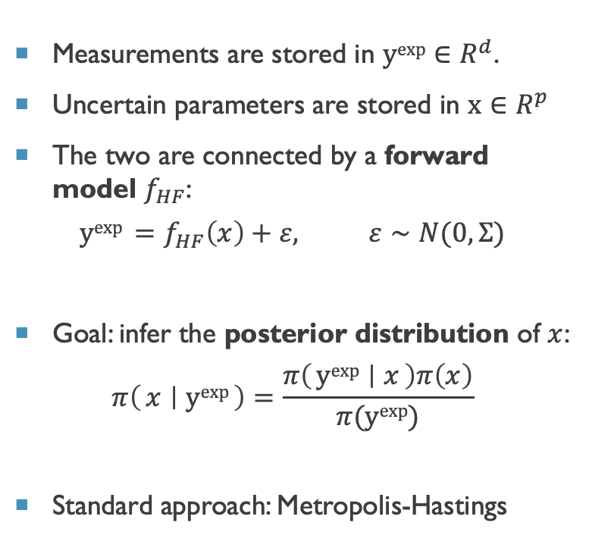
General Framework - Metropolis Hastings
Measurements are stored in $yexp∈R^{d}$.
Uncertain parameters are stored in $x∈R^{p}$
The two are connected by a forward model $f_{HF}$:
$$yexp =f_{HF}\left(x\right)+ε, ε∼N(0,Σ)$$
Goal: infer the posterior distribution of $x$:
$$π\left(x ∣ yexp\right)=\frac{π\left(yexp ∣ x\right)π\left(x\right)}{π(yexp)}$$
Standard approach: Metropolis-Hastings

Slide 5


General Framework - Metropolis Hastings
Measurements are stored in $yexp∈R^{d}$.
Uncertain parameters are stored in $x∈R^{p}$
The two are connected by a forward model $f_{HF}$:
$$yexp =f_{HF}\left(x\right)+ε, ε∼N(0,Σ)$$
Goal: infer the posterior distribution of $x$:
$$π\left(μ ∣ yexp\right)=\frac{π\left(yexp ∣ x\right)π\left(x\right)}{π(yexp)}$$
Standard approach: Metropolis-Hastings
Accept/Reject Parameters
Evaluate Likelihood
Propose parameters
High Fidelity
Model
Benjamin Peherstorfer, Karen Willcox, and Max Gunzburger. Survey of multifidelity methods in uncertainty propagation, inference, and optimization. Siam Review,60(3):550–591, 2018.

Slide 6

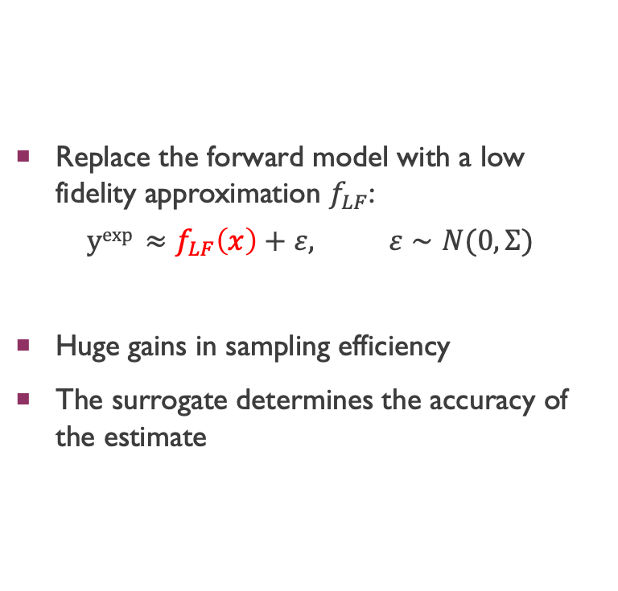
General Framework - Low Fidelity
Replace the forward model with a low fidelity approximation $f_{LF}$:
$$yexp ≈f_{LF}\left(x\right)+ε, ε∼N(0,Σ)$$
Huge gains in sampling efficiency
The surrogate determines the accuracy of the estimate
Accept/Reject Parameters
Evaluate Likelihood
Propose parameters
High Fidelity
Model
Low Fidelity
Model
Zacchei, Filippo, et al. "Neural networks based surrogate modeling for efficient uncertainty quantification and calibration of MEMS accelerometers." International Journal of Non-Linear Mechanics 167 (2024): 104902.

Slide 7
Surrogate Modeling
Surrogate models replace computationally expensive forward models, enabling efficient Bayesian inference.
This transforms the inverse problem into a statistical learning task, where the surrogate approximates the high-fidelity model behavior.
Key Considerations:
✅ Error Quantification:
We must estimate surrogate errors accurately, as they propagate into the posterior distribution and may bias inference.
✅ Data Efficiency:
Surrogates must be trained on fewer samples than needed for direct MCMC, making data efficiency essential.
Gaussian Process Regression!

Slide 8
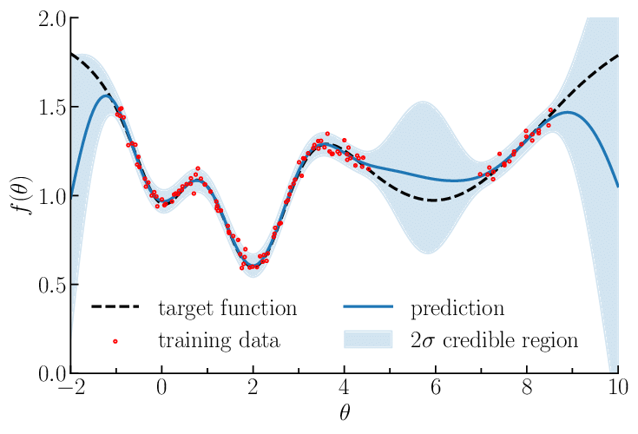
Gaussian Process Regression
A Gaussian Process is a distribution over functions:
f(x) ~ GP(m(x), k(x, x’))
• m(x): mean function (often assumed zero)
• k(x, x’): covariance (kernel) function
🔍 Gaussian Process Regression
Given training data D = {X, y} and observation noise σₙ²,
the GP posterior at a test point x* is:
Mean prediction:
μ(x*) = k*ᵀ (K + σₙ² I)⁻¹ y
Predictive variance:
*σ²(x*) = k(x*, x*) - k*ᵀ (K + σₙ² I)⁻¹ k*

Slide 9
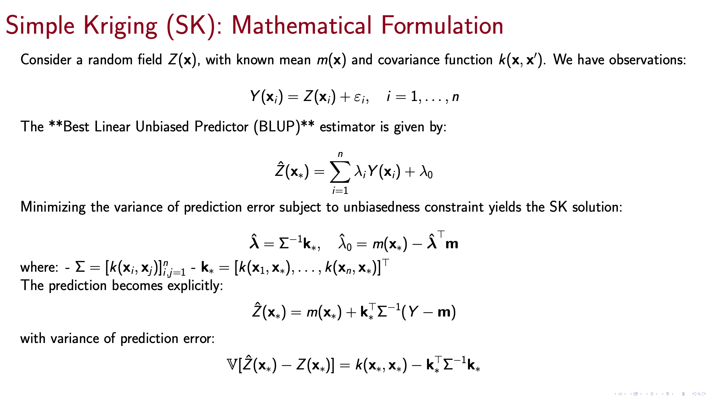

Slide 10
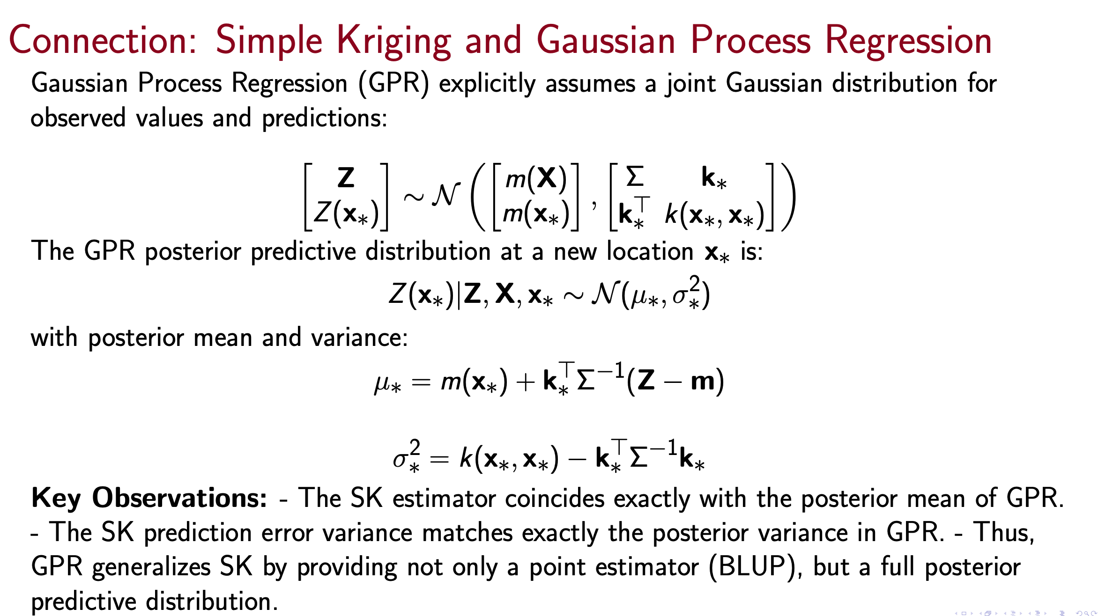
Marinescu, Marius. "Explaining and Connecting Kriging with Gaussian Process Regression." arXiv preprint arXiv:2408.02331(2024).

Slide 11
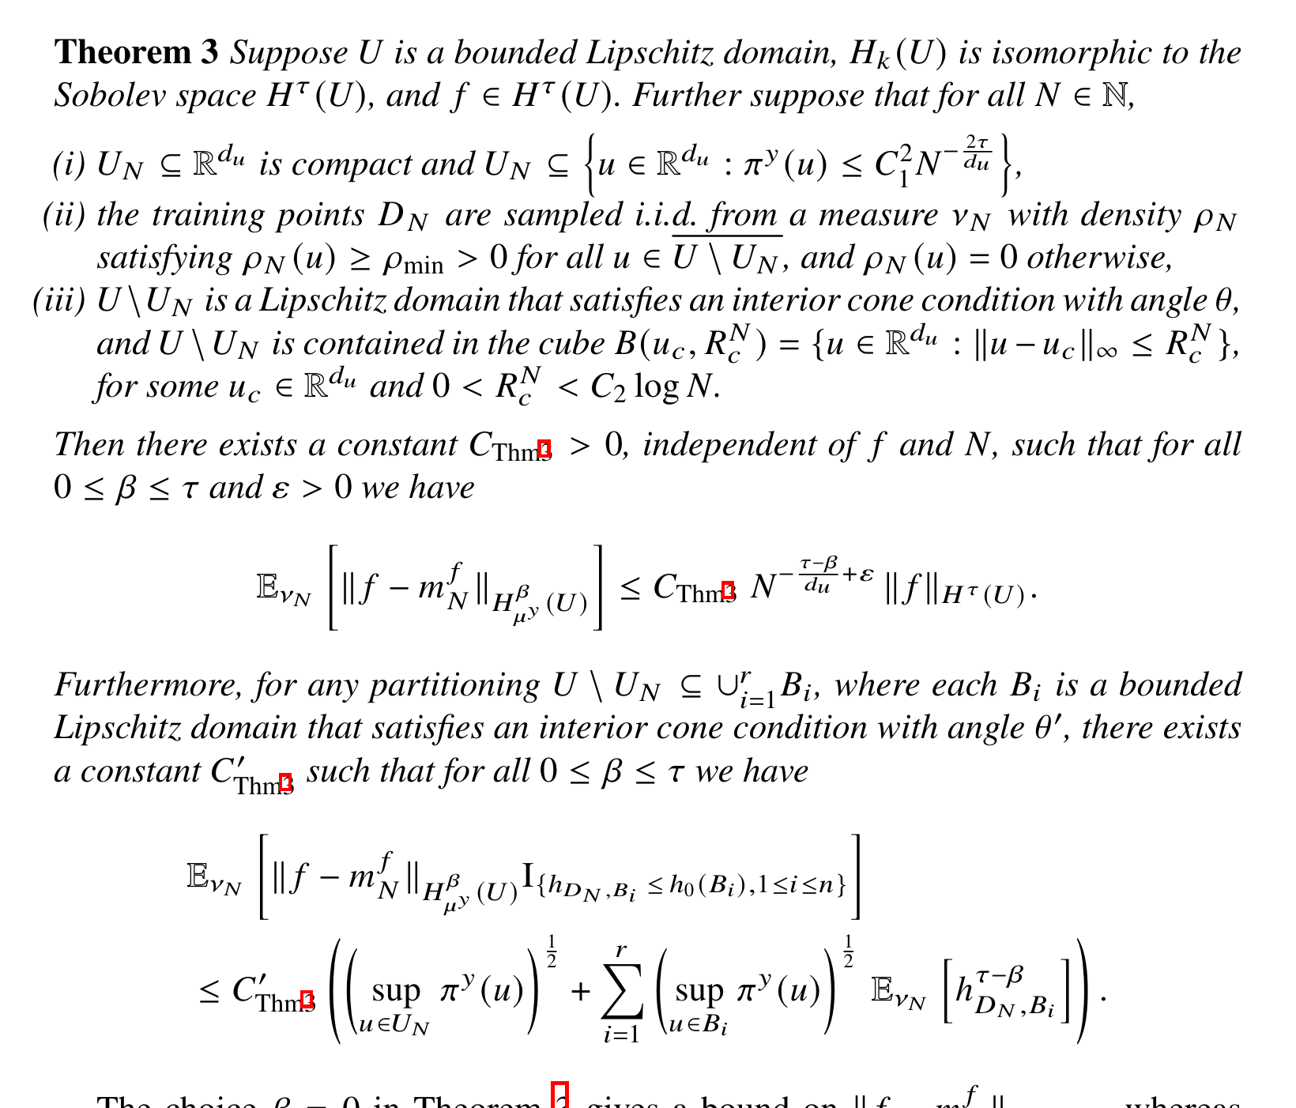
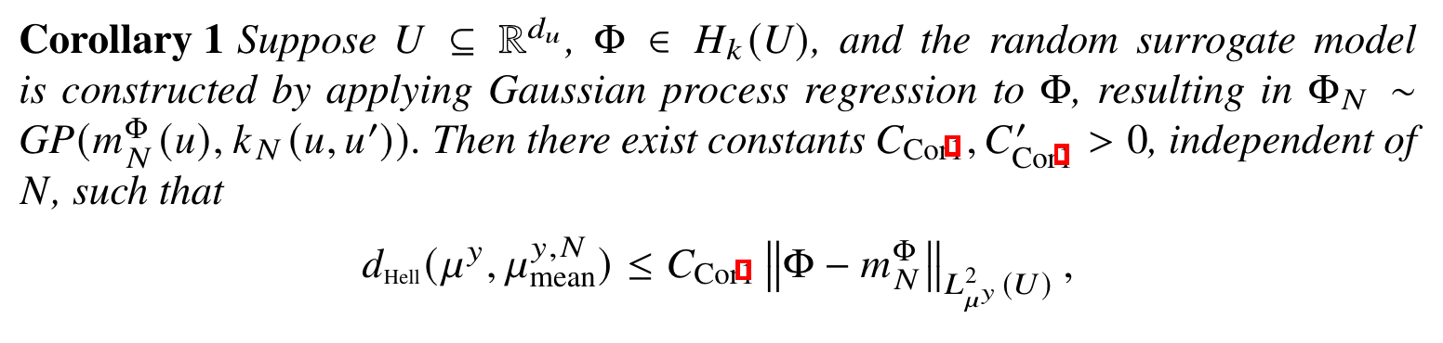
Accuracy Results
Remark: accuracy is optimal when our sampling points are close to the posterior!
Helin, Tapio, et al. "Introduction To Gaussian Process Regression In Bayesian Inverse Problems, With New ResultsOn Experimental Design For Weighted Error Measures." arXiv preprint arXiv:2302.04518 (2023).

Slide 12
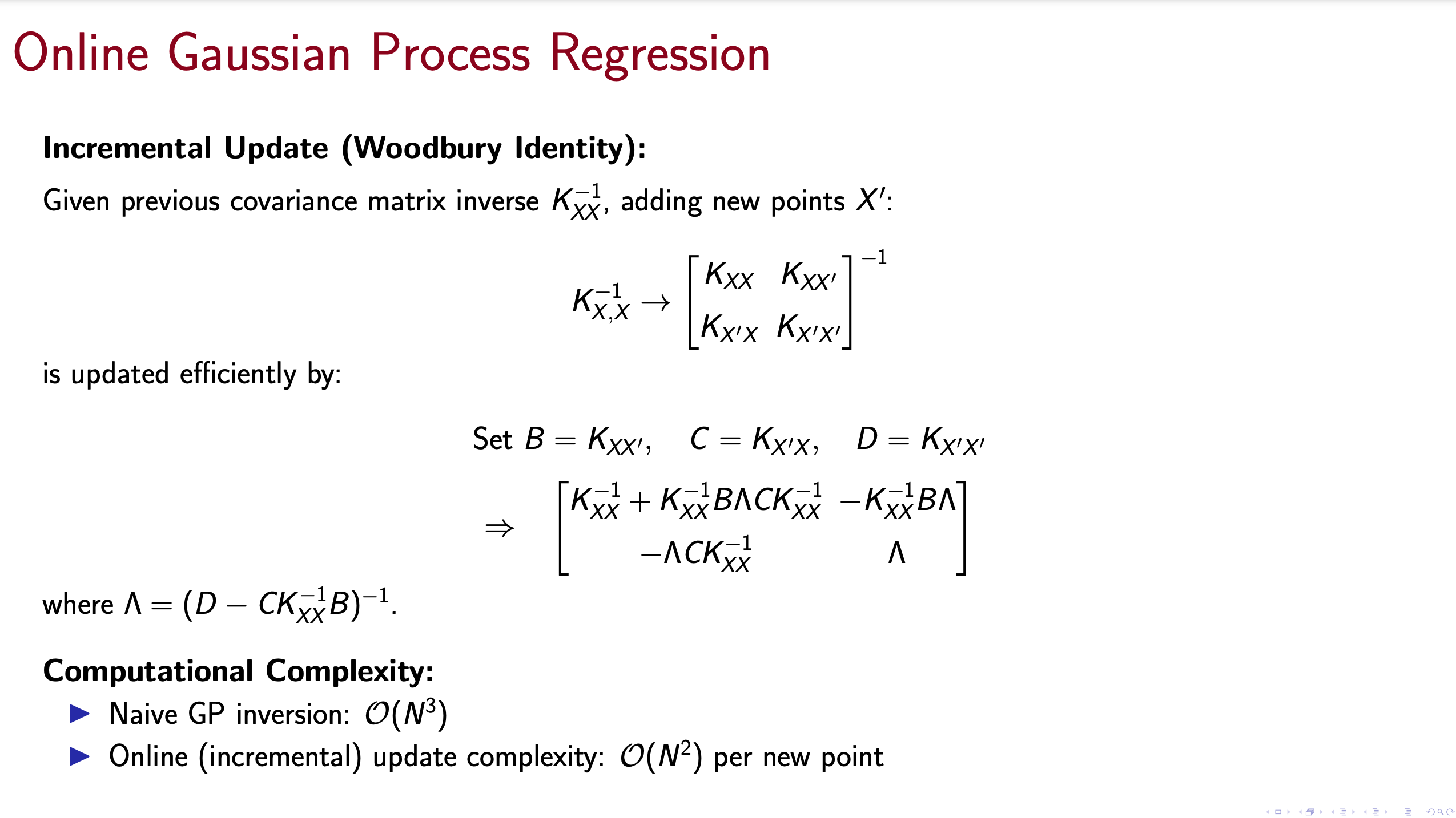
Our goal is to train the GP model during the MCMC!

Slide 13
Numerical results

Slide 14
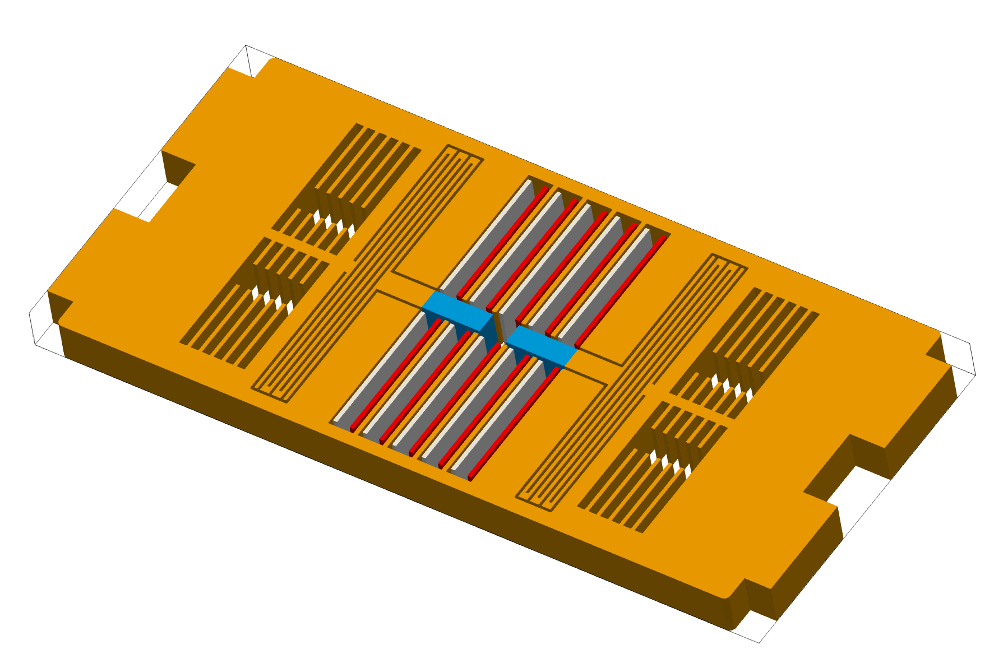
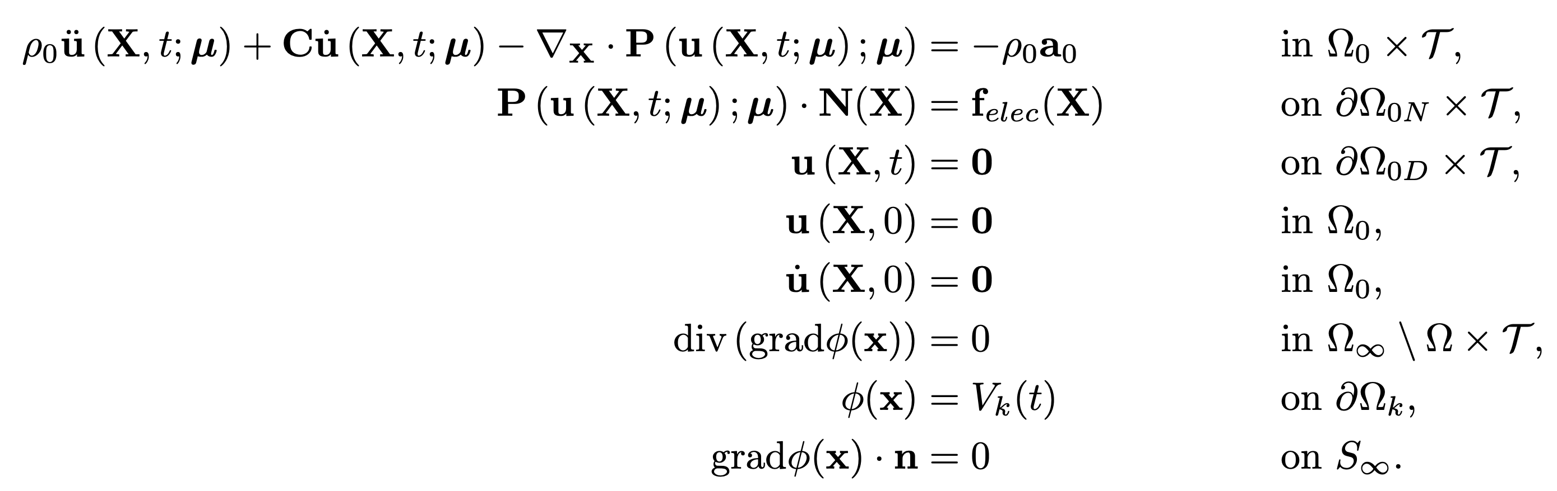
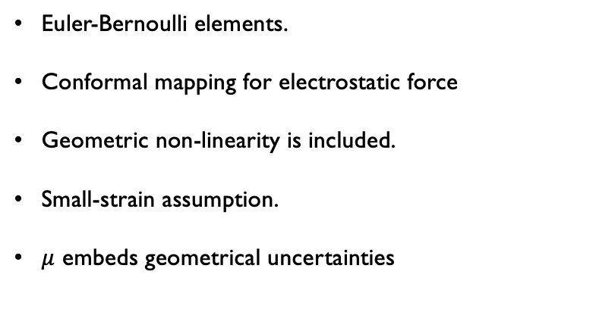
3D Model
Components
 | Shuttle mass1
 | Left Electrodes
 | Right Electrodes
 | Anchors
 | Folded Beams = Springs
 | Air damper
Mathematical Model
Euler-Bernoulli elements.
Conformal mapping for electrostatic force
Geometric non-linearity is included.
Small-strain assumption.
$μ$ embeds geometrical uncertainties

Slide 15
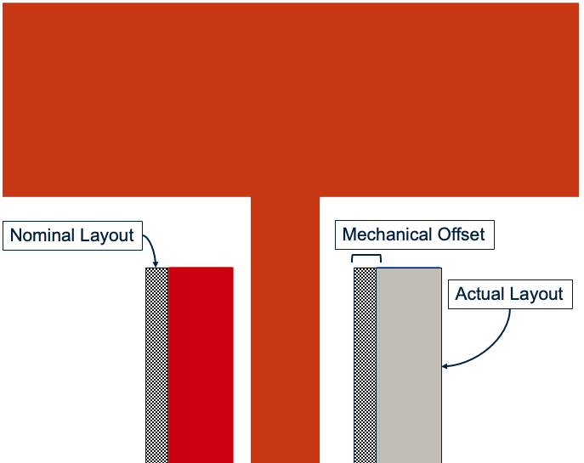
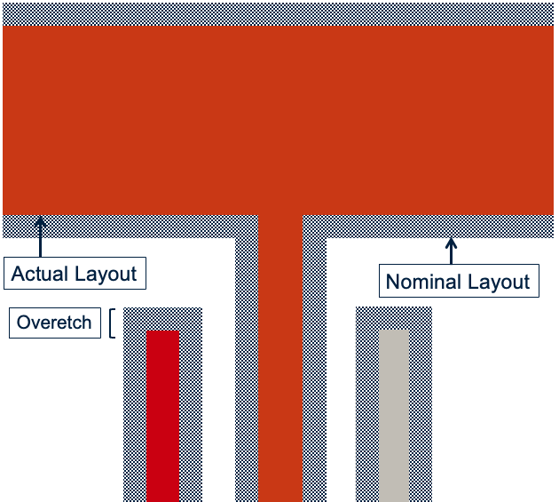
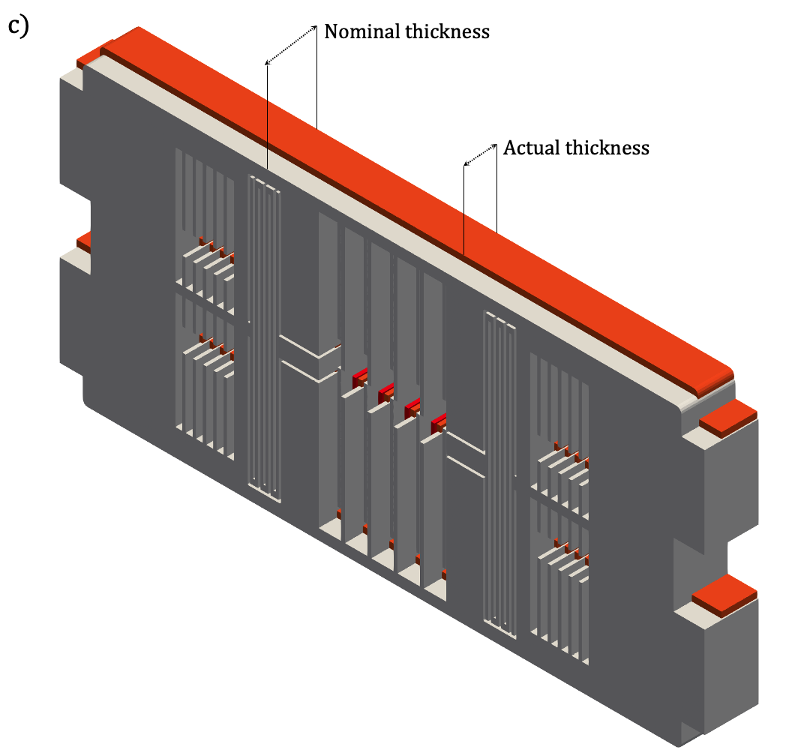
Fabrication Inaccuracies
1: Mechanical Offset
2: Unilateral Overetch
3: Epipoly Thickness
Zacchei, Filippo, et al. "Neural networks based surrogate modeling for efficient uncertainty quantification and calibration of MEMS accelerometers." International Journal of Non-Linear Mechanics 167 (2024): 104902.

Slide 16
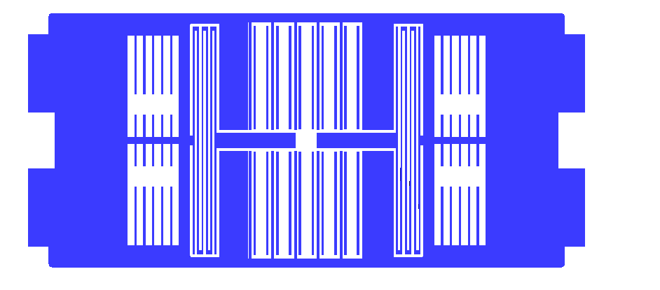
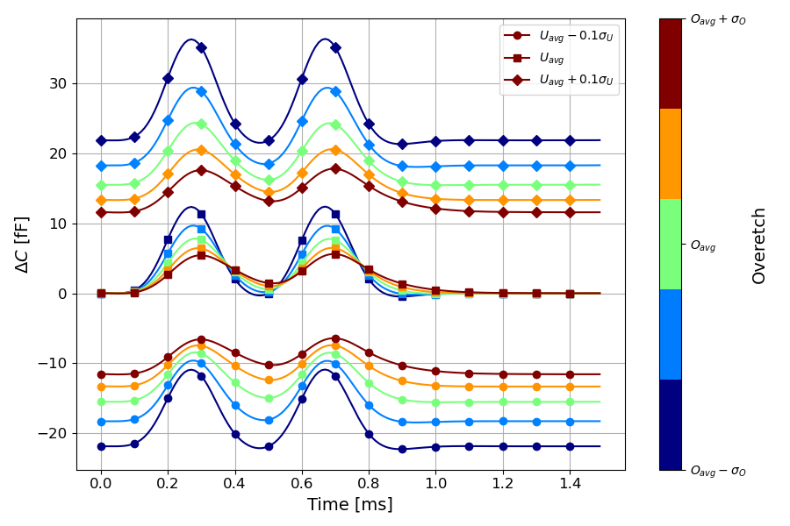
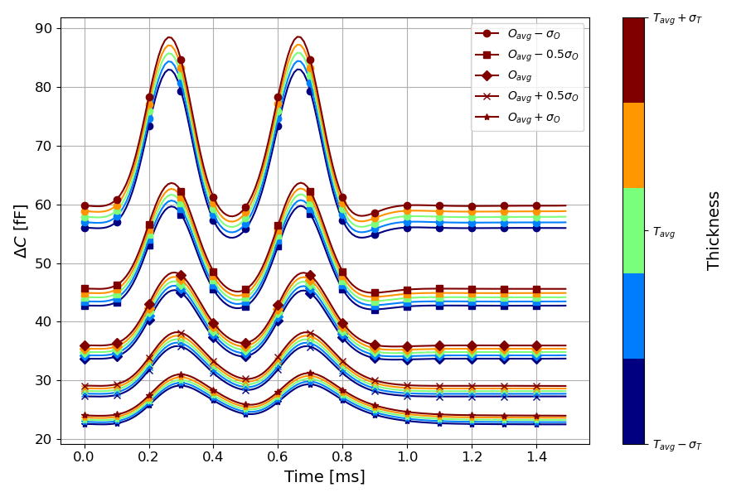
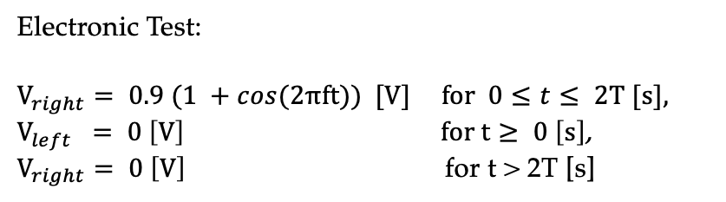
Simulation Setup
Electronic Test:
$$V_{right}= 0.9 (1 +cos(2πft)) [V] for 0≤t≤ 2T [s],$$
$V_{left} = 0 \left[V\right] for t≥ 0 \left[s\right]$,
$V_{right}= 0 \left[V\right]$ for t > 2T [s]

Slide 17
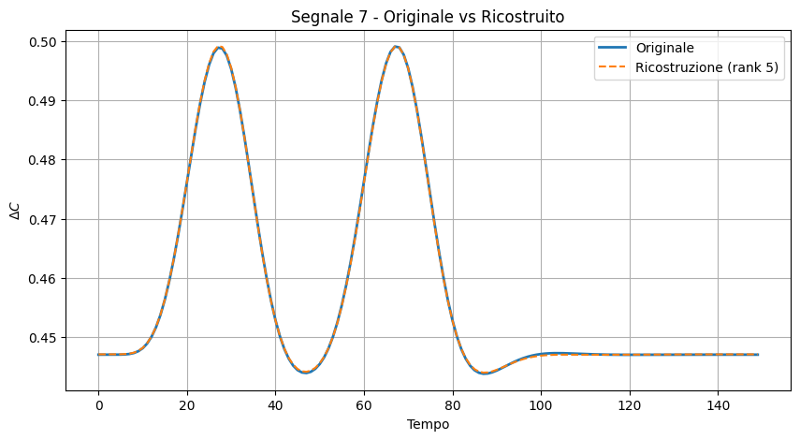
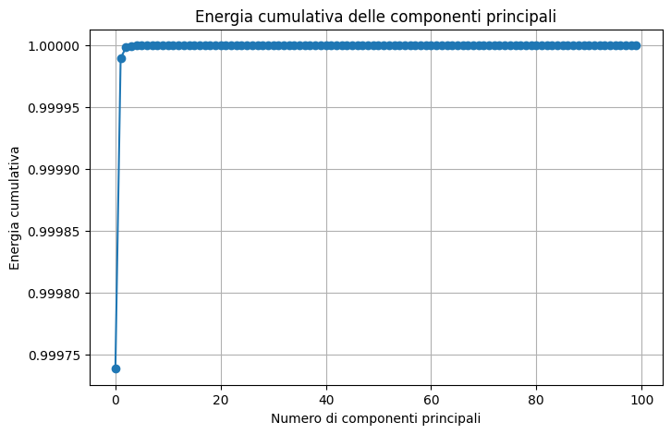
Dimensionality Reduction: POD-GP
In order to have a surrogate for the time series, we decompose the signal using SVD.
We then train an independent GP to approximate each POD mode coefficient.
The POD guarantees that the coefficients of distinct POD modes are independent, thereby avoiding the need of a multi-output GP.

Slide 18
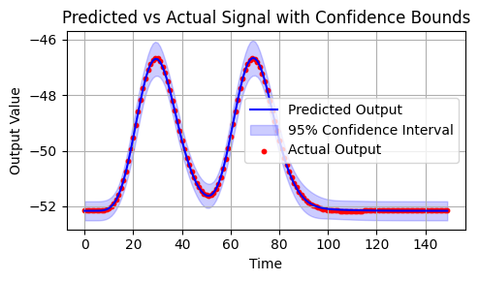
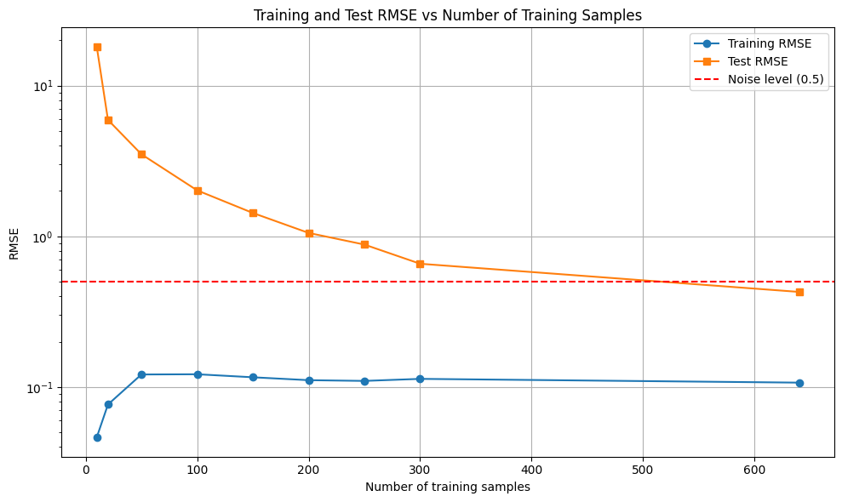
Accuracy
High accuracy is obtained when increasing the number of samples.
Our goal is to minimize the number of training data online: therefore we will stop at 100.

Slide 19
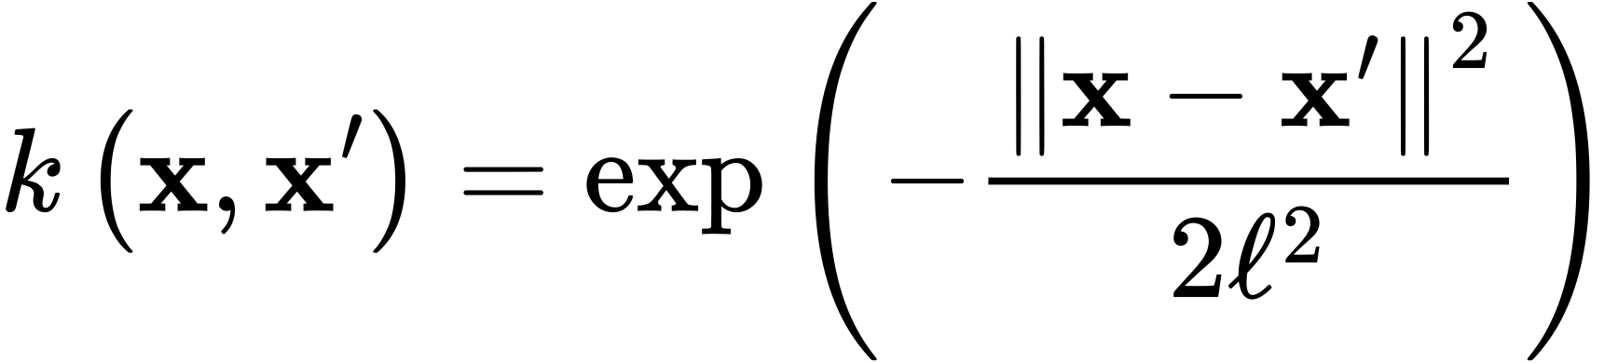
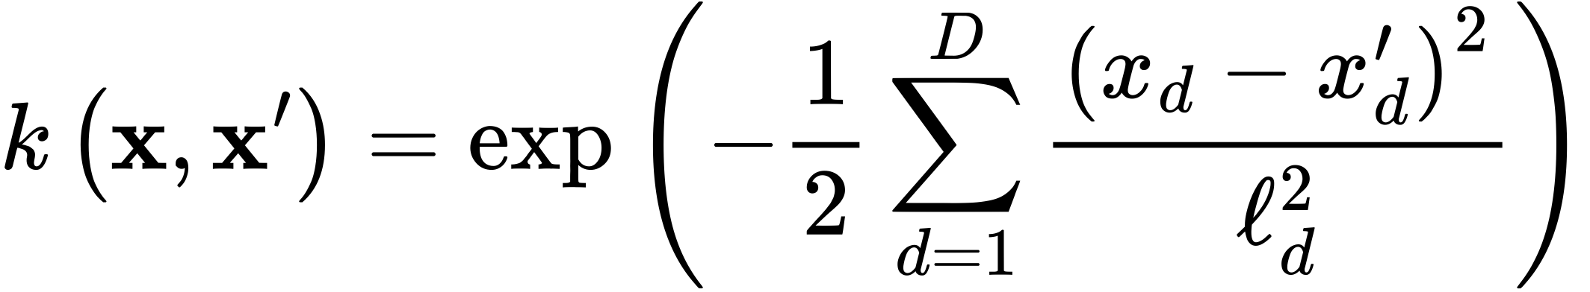
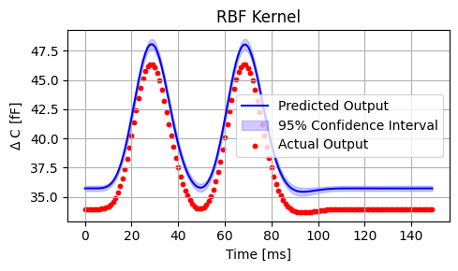
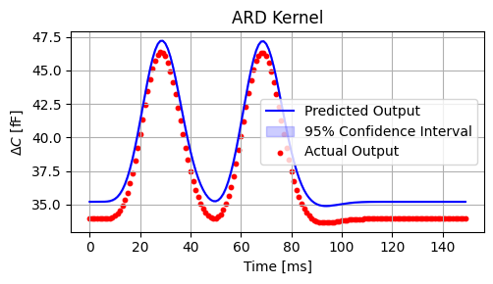
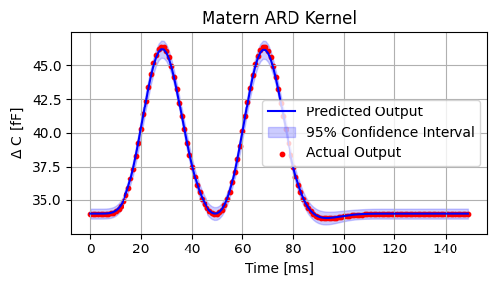
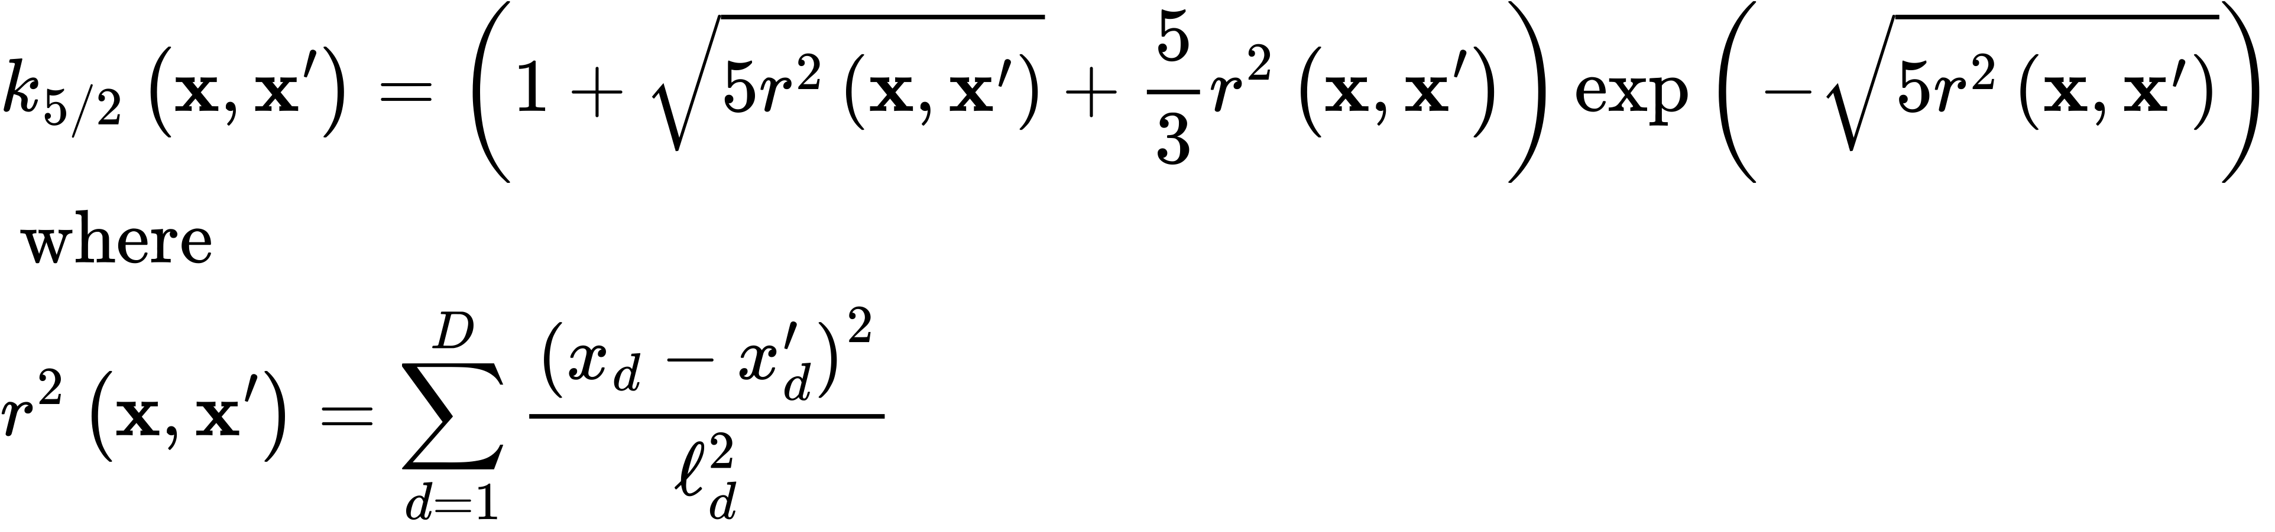
COVariance Kernel ROLE

Slide 20
Active Sampling STrategy
Use a Delayed Acceptance Algorithm for solving the inverse problem.
At coarse level we use the GP - likelihood, adjusted by the covariance.
At fine level, we use the FOM.
Every 5 steps, we fit the GP introducing New Point.
When the GP standard deviation becomes negligigble, we stop training and switch to only surrogate

Slide 21
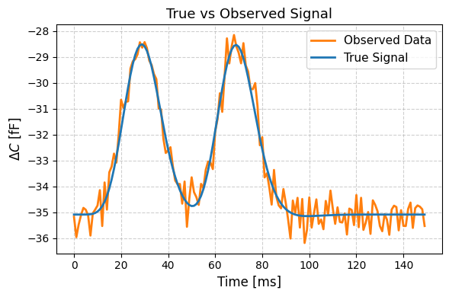
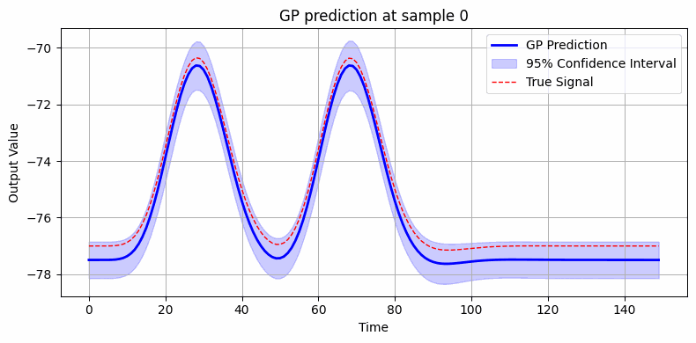
Online Sampling

Slide 22
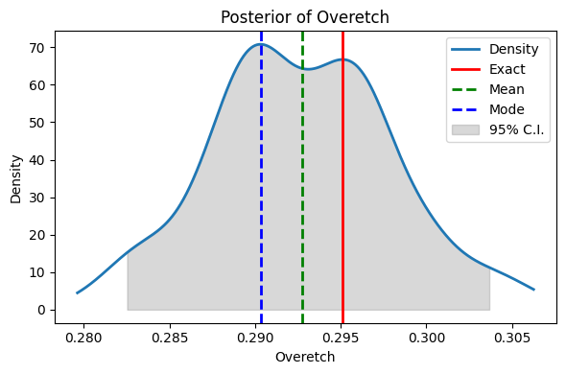
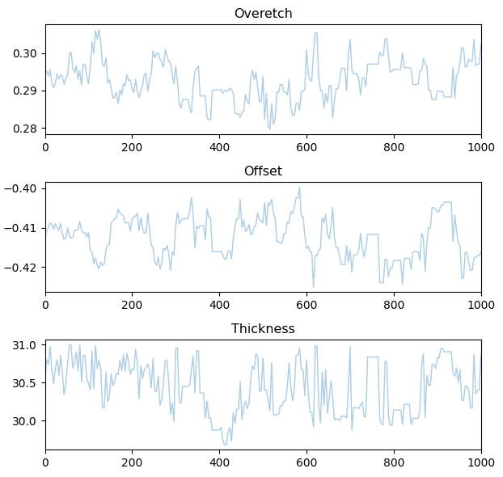
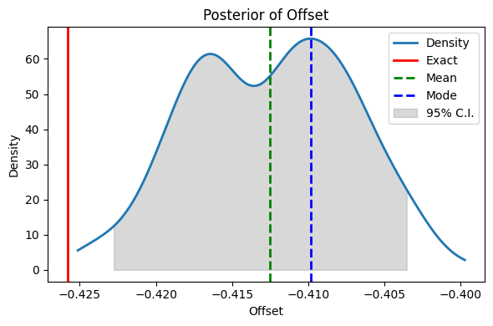
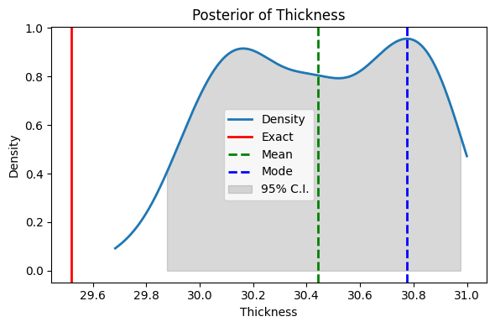
GP - MCMC

Slide 23
Conclusion
The active sampling allows to reduce by a factor of 4 the total number of samples need to train the GP.
Numerical Issues in inverse correction reduce the effectiveness of the method, for which a regularization is introduced, limiting the accuracy of the method.
Preconditioning techniques should be investigated.
In general, the method allows to drastically reduce the computational times needed for MCMC with good accuracy.

Slide 24
Bibliography
Marinescu, Marius. "Explaining and Connecting Kriging with Gaussian Process Regression." arXiv preprint arXiv:2408.02331(2024).
Helin, Tapio, et al. "Introduction To Gaussian Process Regression In Bayesian Inverse Problems, With New ResultsOn Experimental Design For Weighted Error Measures." arXiv preprint arXiv:2302.04518 (2023).
Zacchei, Filippo, et al. "Neural networks based surrogate modeling for efficient uncertainty quantification and calibration of MEMS accelerometers." International Journal of Non-Linear Mechanics 167 (2024): 104902.
[2] Benjamin Peherstorfer, Karen Willcox, and Max Gunzburger. Survey of multifidelity methods in uncertainty propagation, inference, and optimization. Siam Review,60(3):550–591, 2018.

